Slide 1

STATS 432 Computational Statistics
Tutorial 5 – Metropolis-Hastings Algorithm

Slide 2

Question 1

Slide 3


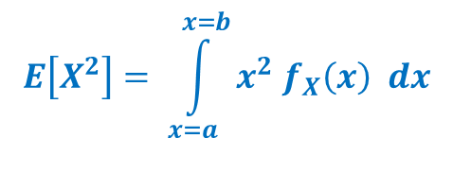
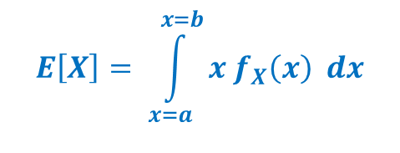
Question 1 :
Question 1
Consider the continuous random variable X defined by the following probability density function…
$$f_{X}\left(x\right) = \left\{\begin{matrix}\frac{30}{31} x^{2} {\left(1 −x\right)}^{2} & if & x∈[1,2] \\ 0 & if & x∉[1,2]\end{matrix}\right.$$
Analytically calculate the value of $E\left[X\right], E[X^{2}]$ and $Var\left[X\right].$ The following formulas will help you
$$E\left[X\right]= \int_{x=a}^{x=b}{x f_{X}\left(x\right) dx}$$
$$E\left[X^{2}\right]= \int_{x=a}^{x=b}{x^{2} f_{X}\left(x\right) dx}$$
$$Var\left[X\right]= E\left[X^{2}\right] −{\left( E\left[X\right] \right)}^{2}$$
Create a function in R which uses a normal random walk proposal density within the Metropolis-Hastings algorithm to produce a sequence of observations drawn from $f_{X}(x)$. Your function must have the following arguments…
MetHat <- function( n, start, proposal_sd)
… where ‘n’ is the number of observations to be produced, ‘start’ is the starting value of the chain and ‘proposal_sd’ is the standard deviation of the normal proposal density
3

Slide 4

Question 1 :
Question 1
Run your algorithm with the following parameters….
burnin <- 1000 # Length of burn-in mcmc <- 9000 # Length of post-burn-in chain set.seed(12345) MH_Output <- MetHat( n = burnin + mcmc, start = 1.5, proposal_sd = 0.25)
Specify the acceptance rate of the algorithm.
Create a time series plot of all elements in the chain AFTER the burn-in.
Create an autocorrelation plot of all elements in the chain AFTER the burn-in.
Use the post burn-in values of the chain to approximate $E\left[X\right], E[X^{2}]$ and $Var\left[X\right].$ Compare your results to the actual values calculated in part a).
4

Slide 5
Question 2

Slide 6

Question 2 :
Question 2
Save the code you produced for Question 1 as a new (differently named) R file.
Create a function in R which uses a uniform independence sampler within the Metropolis-Hastings algorithm to produce a sequence of observations drawn from $f_{X}(x)$. Your function must have the following arguments…
MetHat1 <- function( n, start)
… where ‘n’ is the number of observations to be produced and ‘start’ is the starting value of the chain.
Run your algorithm with the following parameters….
burnin <- 1000 # Length of burn-in mcmc <- 9000 # Length of post-burn-in chain set.seed(12345) MH_Output <- MetHat1( n = burnin + mcmc, start = 1.5)
Use the post burn-in values of the chain to approximate the integral $\frac{30}{31}\int_{x=1}^{x=2}{ln(\sqrt{x}) x^{2} {\left(1 −x\right)}^{2}dx}$
6

